Slide 1

Healthcare Inefficiency: Is it a Chronic Disease?
Kobi Glazer
The Coller School of Management
Tel Aviv University
And
The Department of Economics
The University of Warwick

Slide 2
Health care systems may differ from each other with respect to objectives or goals, but they all try to be efficient.
Efficiency is the means to achieve your goals, whatever your goals are.

Slide 3
Indeed, in the last three or four decades a great deal of effort has been invested by policy makers, health care leaders and managers, in trying to increase the efficiency (as well as equity) of their systems.
The effort has taken various directions: organizational, structural, regulatory, legal and, most of all, economic.
However, as numerous papers, studies and reports have demonstrated, much of this work has been only partially successful, at best.

Slide 4
Efficiency in Health Systems: What Does it Mean
Resources are allocated to those services that yield the highest benefit to patients and treatments are directed to those patients for whom they will be most beneficial.
Some examples of inefficiency:
Patients who are not treated by a provider who has the comparative advantage in treating their specific problem.
Providers who do not choose the most cost effective/cost beneficial treatment for their patients.
Providers who do not invest sufficiently in updating their knowledge of new technologies and procedures.
Insurers and health care providers who avoid offering insurance programs and treatments valuable to patients because they fear that they will attract mainly costly beneficiaries.

Slide 5
Notice: neither lower costs nor better outcomes are, by themselves, evidence of higher efficiency!

Slide 6
The plan for today:
1. What does inefficiency in health care mean?
2. How do we “prove” inefficiency in health care?
3. Try to understand why is it that healthcare systems are inefficient and why it is so hard to fix them.
4. Discuss some attempts to make the systems more efficient.

Slide 7
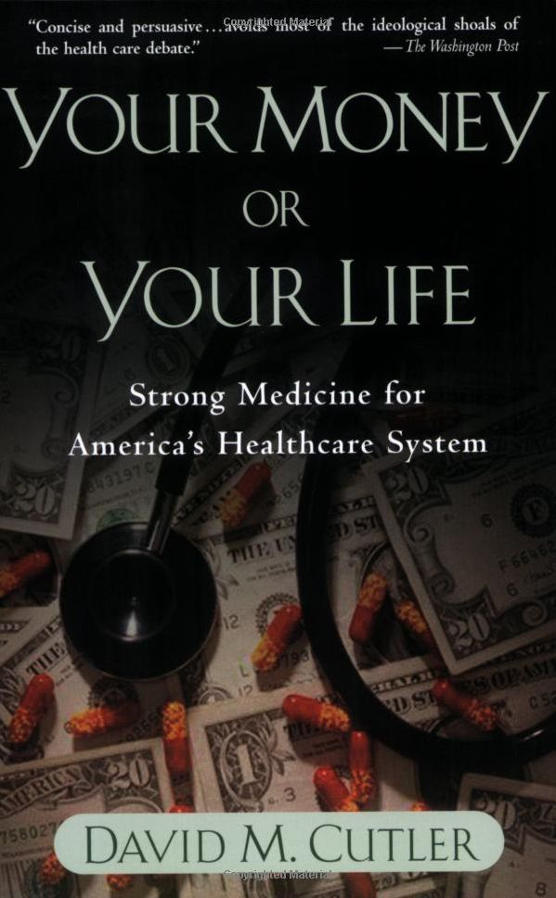

Slide 8
The Gray Area of Medicine
For a person going to the doctor with chest pain, there are over 7,000 cardiology guidelines for individual clinical decisions. For a simple cough, there are over 4,000 infectious disease guidelines, of which 14 percent are based on randomized controlled trials and 55 percent are from opinions or case series (Lee and Vielemeyer, 2011). In addition, many of the guidelines are based on studies excluding people with multiple chronic conditions (often present in the elderly) or based on other non-random samples. Indeed, clinical guidelines in most fields of medicine suffer from poor adherence to methodological standards (Shaneyfelt et al., 1999; Atkins et al., 2004; Dahm et al., 2008).

Slide 9
Is Investment in Health Worthwhile?
Cutler (2004) Possibly the investment in health throughout life since 1960s was worthwhile. However since the 1980s, the increase in expenditures on medical treatment for the elderly is too high compared to the benefit. The health systems should ask whether the medical benefit of this rise is worthwhile. Or, perhaps resources should be directed elsewhere.
Murphy & Topel (2006)
The aggregate value of increased life expectancy since 1970 rose much more than the additional expenditures on health. However, in some groups, especially elderly women, the additional health expenditures were higher than the value of increased life expectancy.

Slide 10
Inefficiency in Health care
OECD 2010, “Health care systems: Getting more value for money”, OECD Economics Department Policy Notes, No. 2. (also in :Joumard, I., C. André and C. Nicq (2010), “Health Care Systems: Efficiency and Institutions”, OECD Economics Department Working Papers, No. 769. )
Key findings are as follows:
- There is room in all countries surveyed to improve the effectiveness of their health care spending. By improving the efficiency of the health care system, public spending savings would be large, approaching 2% of GDP on average in the OECD.
- On average across the OECD, life expectancy at birth could be raised by more than two years, while holding health care spending steady, if all countries were to become as efficient as the best performers.
- There is no health care system that performs systematically better in delivering cost-effective health care.
- There is no “one-size-fits-all” approach to reforming health care systems.

Slide 11
Inefficiency in Health care
Alan M. Garber and Jonathan Skinner, NBER WORKING PAPER SERIES
“IS AMERICAN HEALTH CARE UNIQUELY INEFFICIENT? “2008
Micro-level analyses of specific treatments for comparable patients across countries … suggest that while nearly all countries perform fall well short
of ideal on measures of productive efficiency, the U.S. sometimes (but not always) lags behind.

Slide 12
Variation by Procedure, 1981 rate per 10,000 beneficiaries
CV | Low | Mean | High | Procedure
0.69 | 2 | 9 | 18 | Hip arthroplasty
0.47 | 3 | 9 | 20 | Total Knee
0.41 | 7 | 13 | 23 | CABG
0.37 | 77 | 150 | 260 | Malignant skin Lesion excision
0.31 | 3 | 5 | 8 | Craniotomy
0.31 | 8 | 15 | 24 | Total Hip
0.19 | 2 | 3 | 5 | Appendectomy

Slide 13
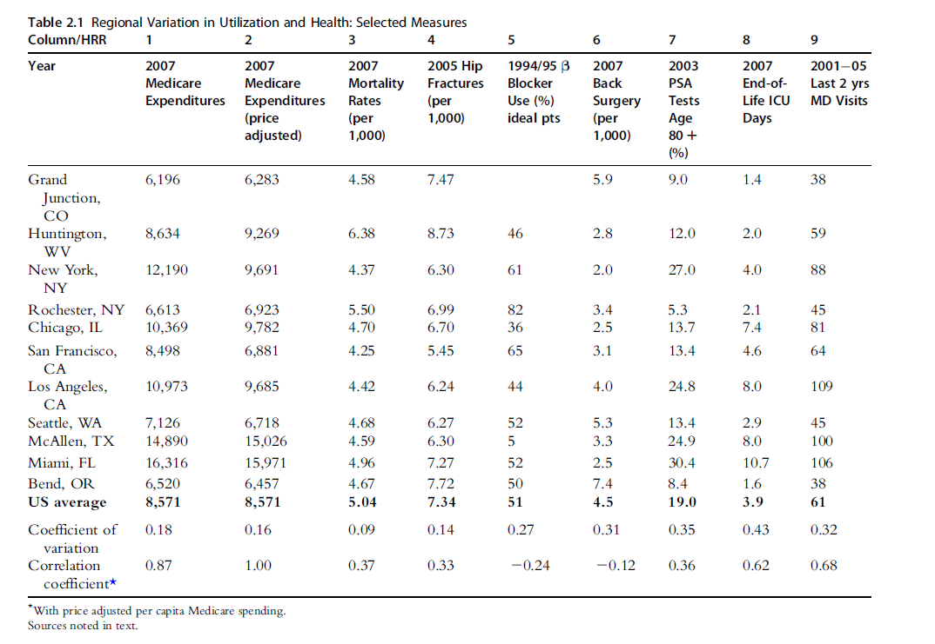

Slide 14
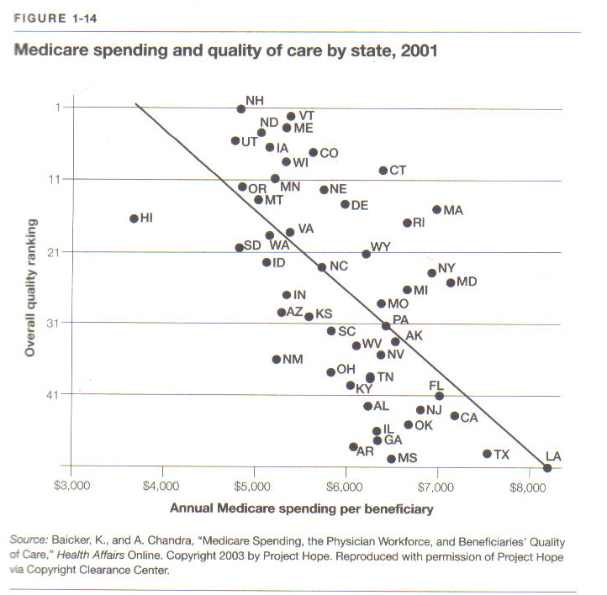

Slide 15
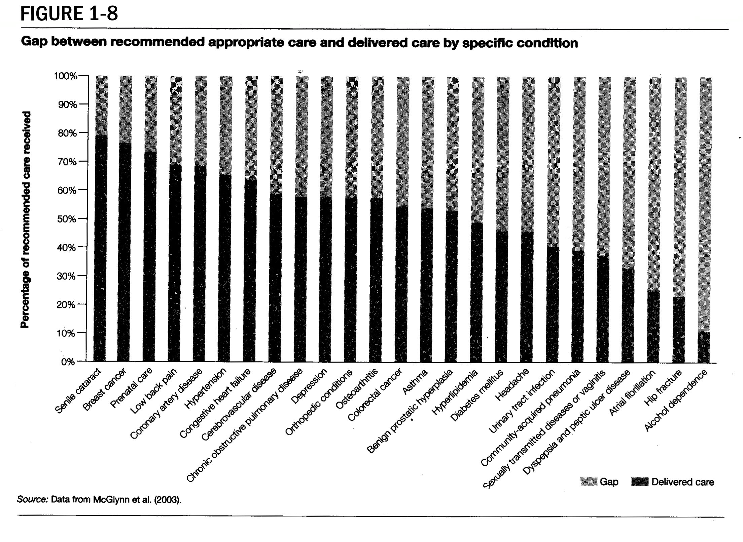

Slide 16
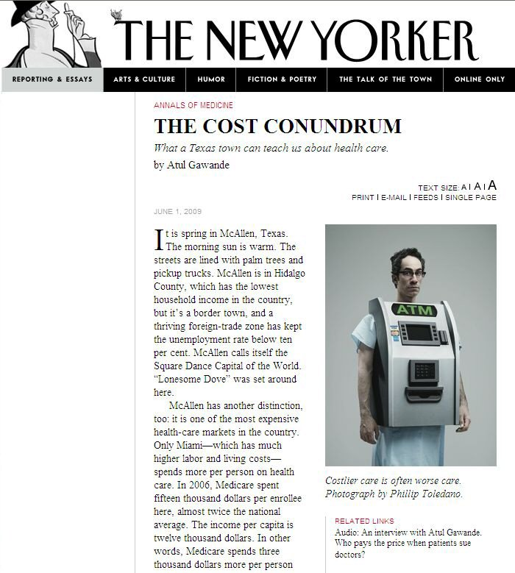

Slide 17
The various (mostly economic) attempts to lower the inefficiency in health systems around the world:
Rationing.
Regulation.
Copayments.
Competition.
Incentives to providers and insurers.
Management.
Information.
Quality indices.
So far, most of these attempts have not been that successful!

Slide 18
“We believe that what gets measured is what gets done”
Scott P. Serota, President and Chief Executive Officer, The Blue Cross and Blue Shield Association

Slide 19
“We believe that what gets measured is what gets done”
If the above claim is not true, then we don’t really know how to induce providers to provide efficient care, without measuring them.
But measuring doctors is often very hard!

Slide 20
EFFICIENCY means customizing the PATIENT’S treatment to :
- the medical problem for which he is seeking treatment
- his genetic and genomic characteristics
- his age, medical history and other medical problems
- other medications and treatments he is getting
- his mental and cognitive state
- his compliance history
- his support at home
- his employment status and the kind of work he does
- the availability of other providers and procedures

Slide 21
Inefficiency in Health care
Jim Hahn, Domestic Social Policy Division, CRS Report for Congress,
“Pay-for-Performance in Health Care,” November 2006.
There are few rigorous objective evaluations of the effect of pay-for-performance programs.
Initial studies suggest that pay-for-performance programs can change performance on quality measures that are used for the basis of bonus payments,
but claims that pay-for-performance programs are cost-saving in the long run are largely unsubstantiated.

Slide 22
Inefficiency in Health care
“Is More Information Better? The Effects of 'Report Cards' on Health Care Providers” David Dranove, Daniel Kessler, Mark McClellan, Mark satterthwaite, 2002
….we find that cardiac surgery report cards in New York and Pennsylvania led both to selection behavior by providers and to improved matching of patients with hospitals.
On net, this led to higher levels of resource use and to worse health outcomes, particularly for sicker patients.
We conclude that, at least in the short run, these report cards decreased patient and social welfare.

Slide 23
THANK YOU

